Slide 1
Finding Triangles in Large Social Network Graphs
GraphHPC
Xiaoyuan Guo, Hanyi Yu, Yifei Ren
April 29. 2019

Slide 2
Outline
Introduction
Objectives
Undirected Graph
Triangle-finding(MPI)
Quadrilateral-finding(MPI)
Spark-based Solution
Directed Graph
Conclusion

Slide 3

Introduction
Most people interact with each other via social media.

Slide 4
Social Network as Graph
Finding triangles can help identify users’ social circle!
Picture adopted from https://www.chilemedia.com/social-media/social/, https://skymind.ai/wiki/graph-analysis

Slide 5
Graph and Triangle
Graph:
Model interactions in various contexts, e.g. social networks
Assume graph is undirected without self-edges
Triangle:
Metrics to evaluate the complexity of graphs
Useful in graph mining
Finding Triangles is important in graph analysis.

Slide 6
Outline
Introduction
Objectives
Undirected Graph
Triangle-finding(MPI)
Quadrilateral-finding(MPI)
Spark-based Solution
Directed Graph
Conclusion

Slide 7
Objectives
1) Design efficient algorithms (MPI & Spark) to count and identify triangles in massive graphs with millions of nodes
2) Extend the algorithms (MPI & Spark) to identify quadrilaterals in large graphs
3) Solve same problems in directed graphs

Slide 8
Outline
Introduction
Objectives
Undirected Graph
Triangle-finding(MPI)
Quadrilateral-finding(MPI)
Spark-based Solution
Directed Graph
Conclusion

Slide 9
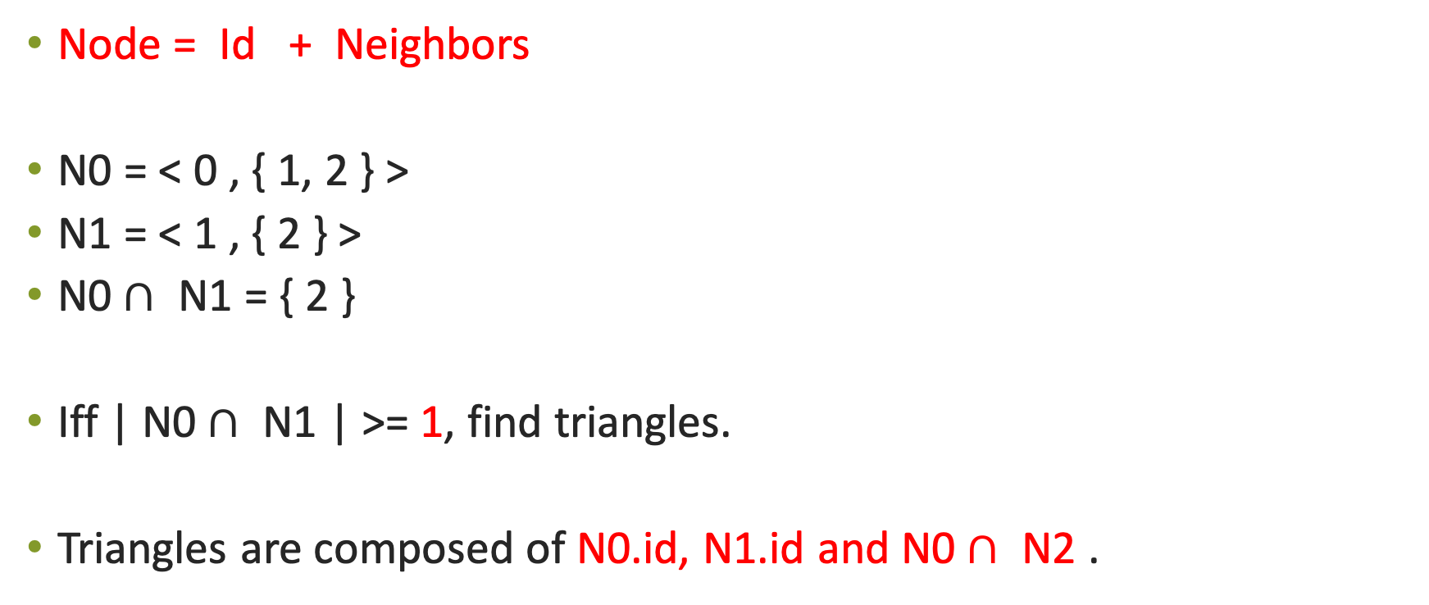
How to find a triangle?
0
Node = Id + Neighbors
N0 = < 0 , { 1, 2 } >
N1 = < 1 , { 2 } >
N0$∩$ N1 = { 2 }
Iff | N0$∩$ N1 | >= 1, find triangles.
Triangles are composed of N0.id, N1.id and N0$∩$ N2 .
1
2
Each edge is stored once!

Slide 10
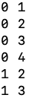
Triangle-finding(MPI)
Problems: when input edge lists become large …
Solution: Split large edge files into smaller ones
4
proc1
0
N0 = < 0 , ( 1, 2, 3, 4 ) >
Request data from proc2
3
2
proc2
N1 = < 1 , ( 2, 3) >
1

Slide 11
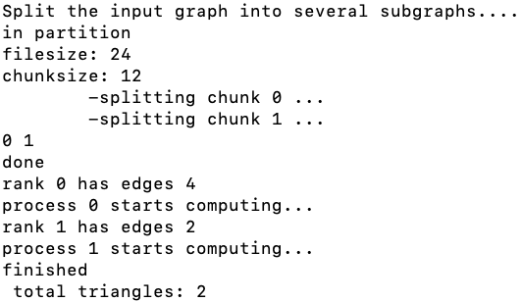
Triangle-finding (MPI) Results
4
0
T2
T1
3
2
1

Slide 12
Outline
Introduction
Objectives
Undirected Graph
Triangle-finding(MPI)
Quadrilateral-finding(MPI)
Spark-based Solution
Directed Graph
Conclusion

Slide 13
Quadrilateral-finding
Based on previous triangle-finding process, quadrilaterals can be formed by two distinct triangles sharing one edge
2
1
1
2
3
0
0
3
4
Yes!
No!!!

Slide 14
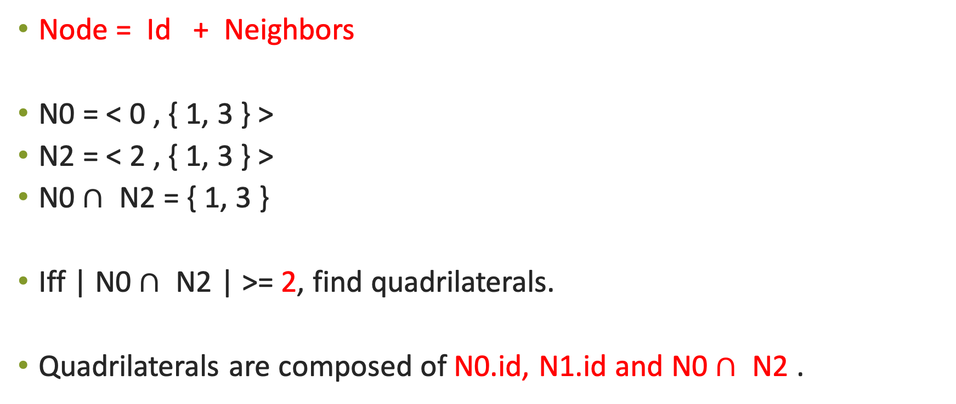
How to find a quadrilateral?
0
Node = Id + Neighbors
N0 = < 0 , { 1, 3 } >
N2 = < 2 , { 1, 3 } >
N0$∩$ N2 = { 1, 3 }
Iff | N0$∩$ N2 | >= 2, find quadrilaterals.
Quadrilaterals are composed of N0.id, N1.id and N0$∩$ N2 .
1
3
2

Slide 15
Find Quadrilaterals in Graphs
Problems: when input edge lists become large …
Solution: Split large edge files into smaller ones
N processors: generate N small edge files
V is the total number of nodes
Each processor has V/N nodes
Example:
2 procs; 8 nodes; 8/2 =4 nodes/proc

Slide 16
N0 = < 0 , { 1, 2, 3, 5 } >
N1 = < 1 , { 0, 2, 6, 7 } >
proc1
proc2
N2 = < 2 , { 0, 1 } >
N3 = < 3 , { 0, 4, 6, 7 } >
proc3
N4 = < 4 , { 0, 1 } >
N5 = < 5 , { 0, 4 } >
proc4
N6 = < 6 , { 1, 3 } >
N7 = < 7 , { 1, 3 } >

Slide 17
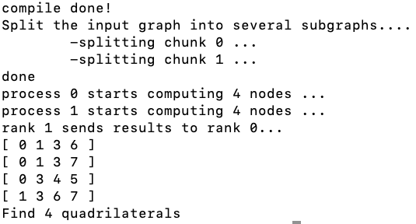
5
2
Q3
4
0
1
Q2
3
Q1
Q4
6
7

Slide 18
Outline
Introduction
Objectives
Undirected Graph
Triangle-finding(MPI)
Quadrilateral-finding(MPI)
Spark-based Solution
Directed Graph
Conclusion

Slide 19
Spark-based Triangle-Finding
(A : B)
(B : A)
A B
Step 1: FlatMap
Step 2: GroupByKey
(A : B1)
(A : B2)
(A : B3)
(A : [B1, B2, B3])
A
B1
B1
A
A
B2
A
B3
B2
B3

Slide 20
Spark-based Triangle-Finding
((B1, B2) : A)
((B1, B3) : A)
((B2, B3) : A)
((A, B2) : -)
((A, B2) : -)
((A, B3) : -)
(A : [B1, B2, B3])
Step 3: FlatMap
B1
A
A
A
A
B1
B2
B1
B3
B2
B3
B2
A
A
A
B3
B1
B2
B3

Slide 21
Spark-based Triangle-Finding
((A, B) : -)
((A, B) : C1)
((A, B) : C2)
Step 4: GroupByKey
Step 5: FlatMap
Step 6: Distinct
((A, B) : [-, C1, C2])
C1
C1
C1
((A, B) : [C1, C2])
None
A
B
OR
A
A
B
B
(A, B, C1)
(A, B, C2)
A
B
((A, B) : [-, C1, C2])
C2
C2
C2

Slide 22
Spark-based Quadrilateral-Finding
Step 1-2: Same as triangle finding
Step 3: FlatMap
Step 4: GroupByKey
Step 5: FlatMap
Step 6: Distinct
((B1, B2) : A) ((B1, B3) : A) ((B2, B3) : A)
(A : [B1, B2, B3])
((A, B) : C1)
((A, B) : C2)
((A, B) : C3)
((A, B) : [C1, C2, C3])
(A, B, C1, C2)
(A, B, C1, C3)
(A, B, C2, C3)
((A, B) : [C1, C2, C3])

Slide 23
5
2
Q3
4
0
1
Q2
3
Q1
Q4
6
7

Slide 24
Outline
Introduction
Objectives
Undirected Graph
Triangle-finding(MPI)
Quadrilateral-finding(MPI)
Spark-based Solution
Directed Graph
Conclusion

Slide 25
Directed Triangle-finding
Idea: use three nested loops to consider every triplet (i, j, k) and check ( i → j, j → k , k → i)
In case of directed graph, the number of permutation would be 3 (as order of nodes becomes relevant). Hence in this case the total number of triangles will be obtained by dividing total count by 3.

Slide 26
def countTriangle(g, isDirected):
nodes = len(g)
count_Triangle = 0 #Initialize result
# Consider every possible triplet of edges in graph
for i in range(nodes):
for j in range(nodes):
for k in range(nodes):
# check the triplet if it satisfies the condition
if( i!=j and i !=k and j !=k and g[i][j] and g[j][k] and g[k][i]):
count_Triangle += 1
# if graph is directed , division is done by 3
# else division by 6 is done
return count_Triangle/3 if isDirected else count_Triangle/6

Slide 27
Directed Triangle-finding Results
Dataset: Stanford Large Network Dataset Collection
https://snap.stanford.edu/data/
Running time: 20.438576s

Slide 28
Spark-based Directed Triangle-finding
1
X | Y
1,2 | 2,1
2,3 | 3,2
3,1 | 1,3
3
2

Slide 29
Spark Based Directed Triangle-finding
Z = Join( X, Y) | A = map(Z) | B = map(X) | join(A, B)
1: (2 , 3) | (2 , 3): 1 | (1 , 2): 0 | (2, 3): [1, 0]
2: (3 , 1) | (3 , 1): 2 | (2 , 3): 0 | (3, 1): [2, 0]
3: (1 , 2) | (1 , 2): 3 | (3 , 1): 0 | (1, 2): [3, 0]

Slide 30
Outline
Introduction
Objectives
Undirected Graph
Triangle-finding(MPI)
Quadrilateral-finding(MPI)
Spark-based Solution
Directed Graph
Conclusion

Slide 31
Conclusion
MPI-based undirected triangle finding algorithm requires input edge files to be ordered.
MPI-based methods split large files into smaller ones; while Spark-based methods use the original input files.
Directed triangle finding is more difficult and time-consuming than undirected triangle finding.

Slide 32
Questions
Picture adopted from https://knowyourteam.com/blog/2017/08/28/the-9-questions-that-uncover-the-most-surprising-feedback-from-employees/

